Slide 1
About the program
Console application
C#
5 classes:
Program – Base code
GardenMap – Class that represents the garden
GrassCutter – Class that represents the grass cutter
CheckingEnvironment – Class that contains the environment checking functions
MoveGrassCutter – Class that contains the functions to move the grass cutter

Slide 2
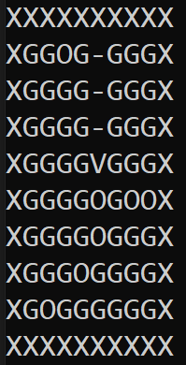
The garden
Two dimensional character matrix
10 x 10 size
4 (8) characters:
X = Fence
O = Obstacle
V, ^, >, < = Grass cutter
G = Uncut grass
– = Cut grass
Obstacles are random

Slide 3
The grass cutter
Starts at random coordinates
Can’t go through fence parts and obstacles
Doesn’t know the size of the garden and the coordinates of the obstacles and fence parts
It chooses its own path by examining environmental elements

Slide 4
Route selection
Examine its one area unit radius
Not found uncut grass → examine in two area unit radius
The first uncut grass found → Move there
What if it can’t find any uncut grass? → It will choose an already cut grass

Slide 5
Preferred directions
Route 1:
Down
Left
Up
Right
Route 2:
Down
Right
Up
Left
Which direction does it examine first?
There are four different preferred direction list
It changes its preferred direction list
Why are there four preferred direction lists?
To minimize the random moves
To avoid as many stucks as possible
To be able to do both I chose this solution
Route 3:
Right
Left
Up
Down
Route 4:
Right
Left
Down
Up

Slide 6
Avoiding stucks
Can stuck with unlucky obstacle placement and not the ideal preferred route for it
The program counts the number of uncut grass parts touched in a row
When it reaches 30 → forcing the grass cutter to change it’s preferred route
The new route can’t be the current route
The program counts the number of forced route changes
When it reaches 5, the program stops

Slide 7
Moving the grass cutter
Searching fur uncut grass →
If it finds one, then it will check that is there any free way to it? →
If it finds a free way → Calling the move function
Changing the grass cutters direction (^, V, >, <)
Leaves cut grass behind

Slide 8
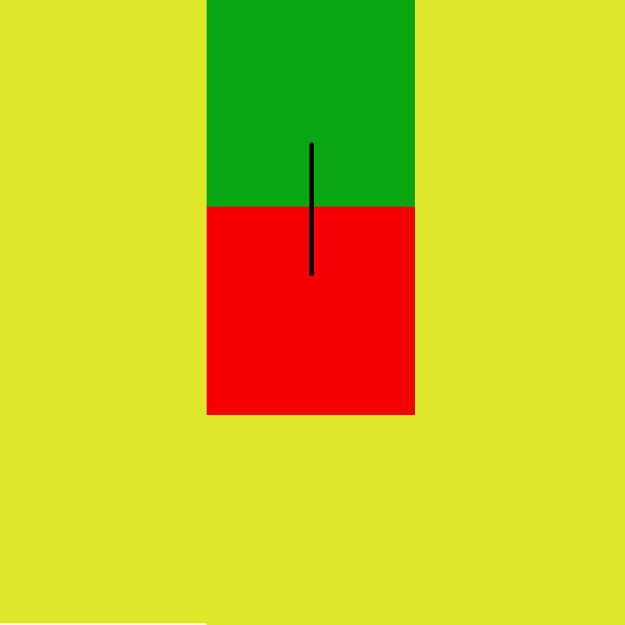
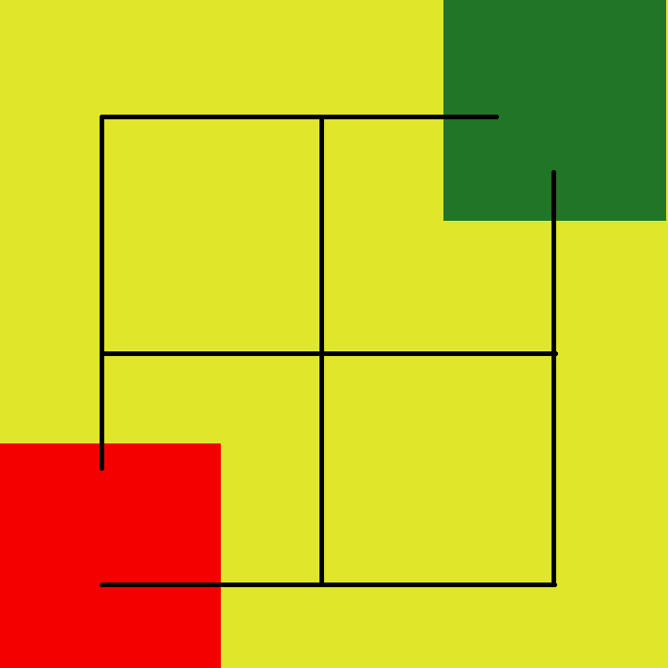
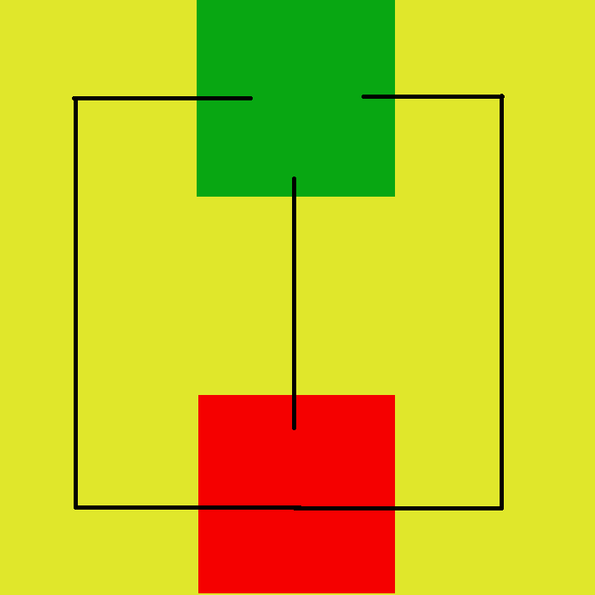
Moving the grass cutter
Difference between one and two area unit radius moves→ Number of possible routes
Checking the possible routes before confirming the next part

